Slide 1

Final Project: Advanced Security Blade
IPS and DLP blades

Slide 2
Agenda
1
IPS
2
DLP
3
About next assignment
4
How to research malware behavior
Notes:
2
2
2

Slide 3
Agenda
1
IPS
2
DLP
3
About next assignment
4
How to research malware behavior
Notes:
3
3
3

Slide 4
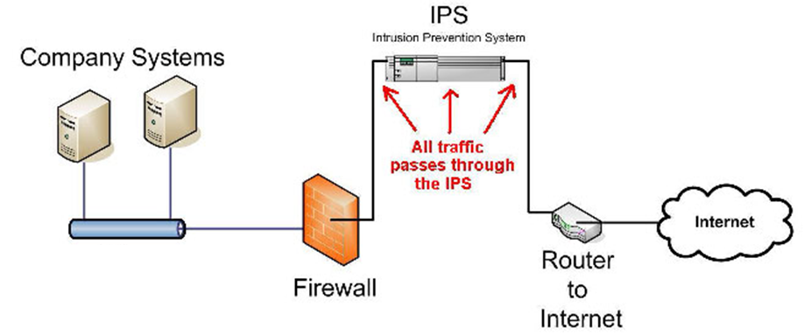
Intrusion Prevention System - IPS
Notes:
An IPS monitors network traffic by analyzing the content of the packets
Each packet is being examined to check if it contains any malicious content that appears in the signatures database
In case a malicious packet is identified and matched to a signature it can raise an alarm or even block the connection if required
Basically an IPS searches for attempts to exploit vulnerabilities within the organization by an external attacker
IPS might affect network performance since it examines all incoming and outgoing network traffic

Slide 5
Intrusion Prevention System - IPS
An IPS monitors network traffic by analyzing the content of the packets
Each packet is being examined to check if it contains any malicious content that appears in the signatures database
In case a malicious packet is identified and matched to a signature it can raise an alarm or even block the connection if required
IPS might affect network performance since it examines all incoming and outgoing network traffic
Notes:
IPS and it’s brother IDS (differs by protection vs. detection). IPS uses a negative security logic – the signatures says what’s forbidden (blacklisted) as opposed to positive security logic where the security administrator specifically lists what is allowed (whitelist).
The IPS is aimed to protect the Application Layer.
The downsides of negative security logic:
False positive vs. False negative – From the eyes of a company owner, which is worse?
Of course a false positive since the one false positive can be a transaction of millions of dollars.

Slide 6
Agenda
1
IPS
2
DLP
3
About next assignment
4
How to research malware behavior
Notes:
6
6
6

Slide 7


Data Leak Prevention - DLP
Notes:
Detect:
Inform User:
Ask User: The users decides if this is a real data leak or a false-positive, everything is logged
Prevent: The traffic is blocked

Slide 8

Data Leak Prevention - DLP
Nowadays sensitive data can be easily accessed and transferred
DLP monitors data transfer by deeply inspecting and analyzing the data, source, destination and protocol
The data can be anything from accounting papers to source code
DLP can work in several ways:
Detect
Inform User
Ask User
Prevent
Notes:
Detect:
Inform User:
Ask User: The users decides if this is a real data leak or a false-positive, everything is logged
Prevent: The traffic is blocked

Slide 9
Agenda
1
IPS
2
DLP
3
About next assignment
4
How to research malware behavior
Notes:
9
9
9

Slide 10
Handle a real world vulnerability
In this final project, you’ll have to deal with real-world problem
In the IPS part, you’ll ask to make a research about the vulnerability – its cause, affect, how does it work etc.
After a complete research, you’ll write the protection to the vulnerability
Your firewall will be tested with real exploits! We will see if your protection can stand against real penetration testing framework

Slide 11
Handle a real world vulnerability
In the DLP part you’ll have to keep an eye in order to minimize network data leakage risks
In order to make it easy for you, we’ll support only http and smtp text
You’ll have to protect your organization's source code by recognizing source code being sent through HTTP (GET, POST) or SMTP
Again, you’ll have to research yourself the methods to support, learn and protect

Slide 12
Agenda
1
IPS
2
DLP
3
About next assignment
4
How to research malware behavior
Notes:
12
12
12

Slide 13
Popular sites for vulnerabilities
You can find useful information in the following websites
https://cve.mitre.org
https://www.corelan.be
http://www.exploit-db.com
http://www.securityfocus.com
https://www.owasp.org
https://www.google.com

Slide 14
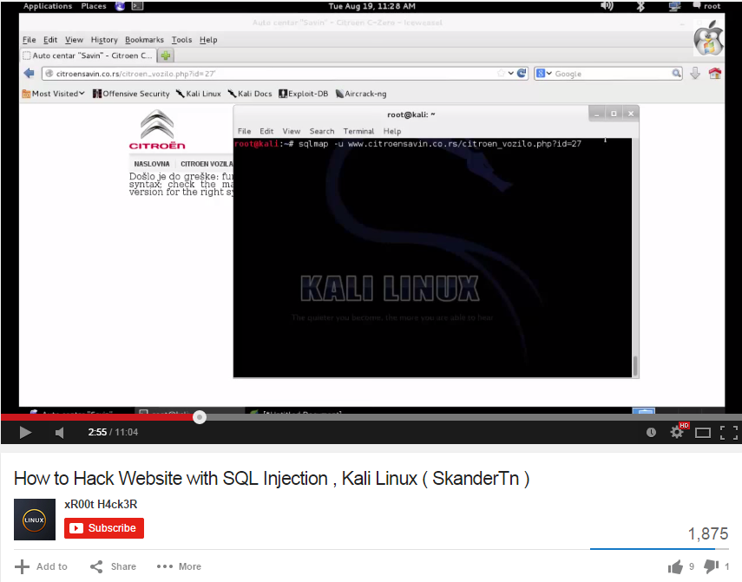
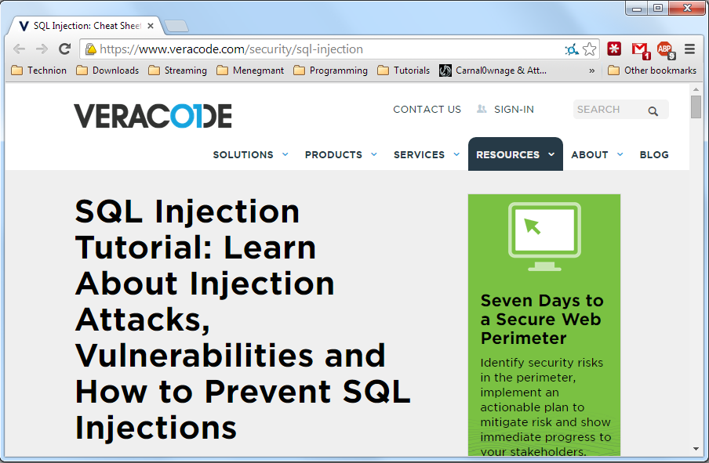
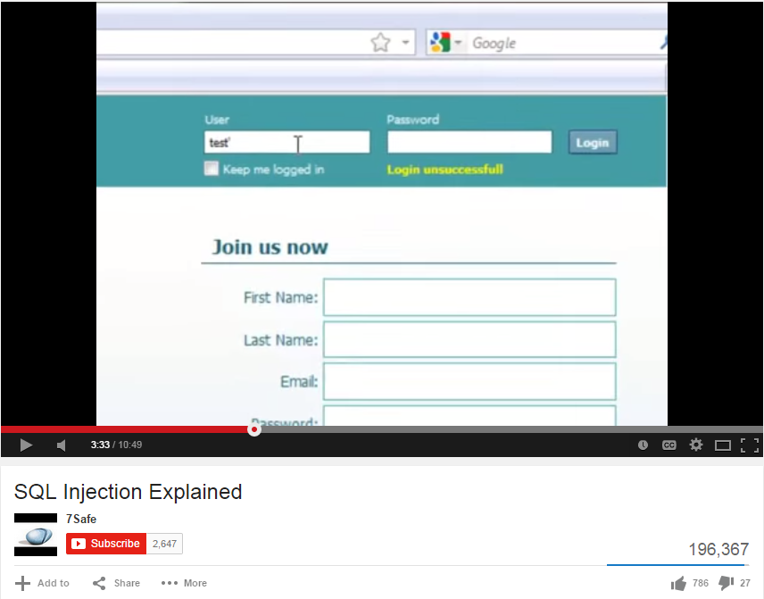
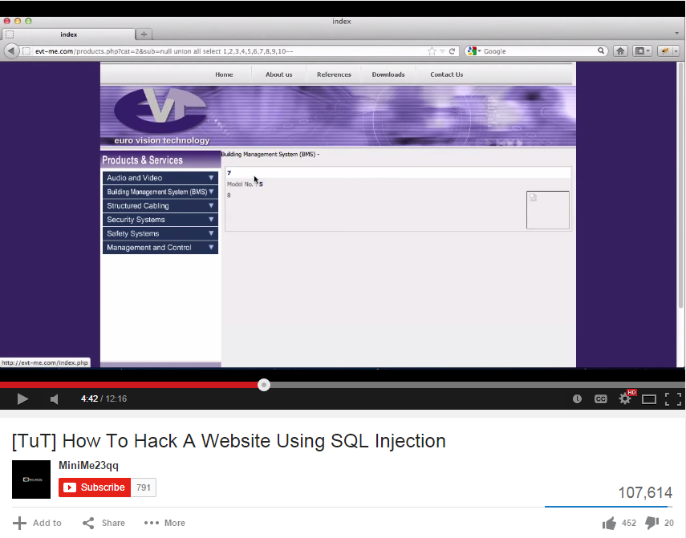
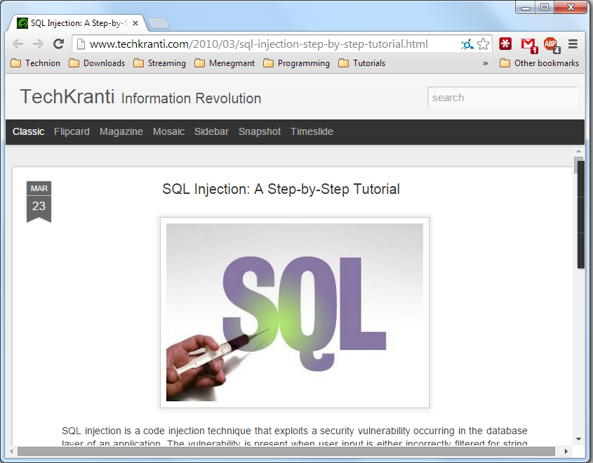
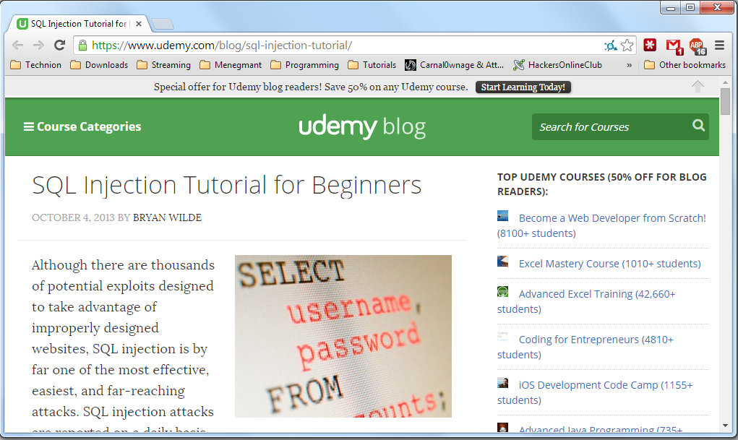
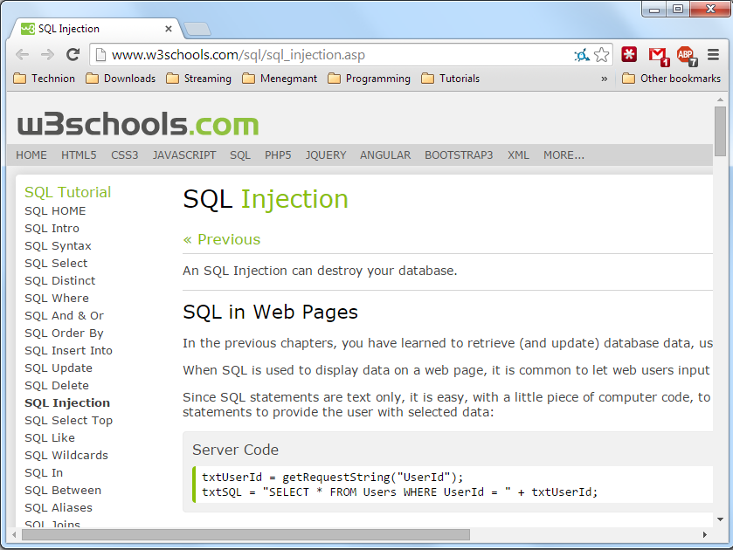
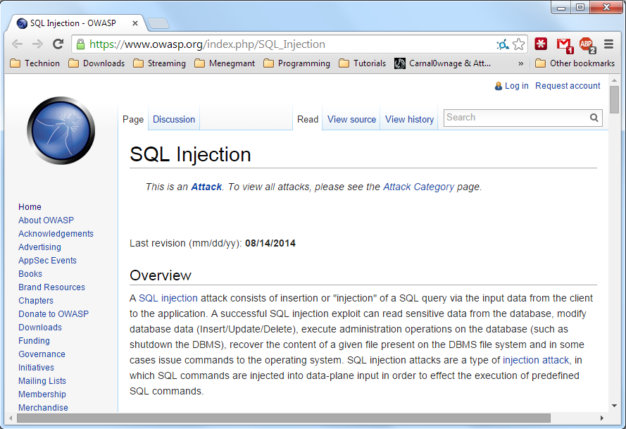
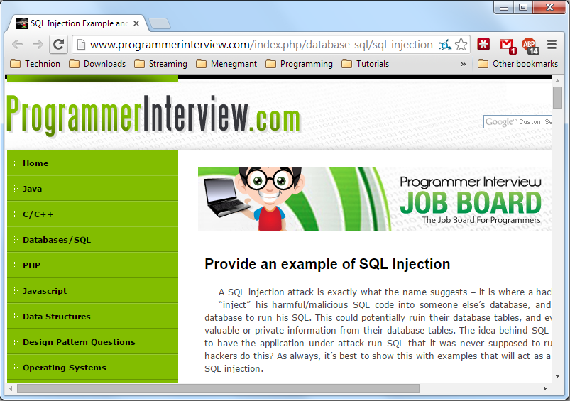
Learn about SQL injection

Slide 15
Metasploit
Metasploit is a useful tool for vulnerabilities testing and research
This tool is integrated in Kali Linux
For this stage, you should consider using this tool for your research
Download the image of Kali Linux (iso file)
Create new virtual machine:
Type: Linux
Version: Debian (32-bit)
Allocate minimum 15GB hard drive

